Slide 1
WEEK 6 - DEMO
ANNIE NGUYEN
January 5, 2018

Slide 2


OUTLINE
SQL
TKWANDERER

Slide 3
For every situation where student A likes student B, but student B likes a different student C, return the names and grades of A, B, and C.
SELECT Hs1.name, Hs1.grade, Hs2.name, Hs2.grade, Hs3.name, Hs3.grade
FROM Likes AS Lk1
LEFT JOIN Likes AS Lk2 ON Lk1.ID2 = Lk2.ID1
LEFT JOIN Highschooler AS Hs1 ON Lk1.ID1 = Hs1.ID
LEFT JOIN Highschooler AS Hs2 ON Lk2.ID1 = Hs2.ID
LEFT JOIN Highschooler AS Hs3 ON Lk2.ID2 = Hs3.ID
WHERE Lk1.ID1 > Lk2.ID2;

Slide 4
Lk1.ID2
= LK2.ID1
Lk1.ID1
Lk2.ID2
A
B
C

Slide 5
For each student A who likes a student B where the two are not friends, find if they have a friend C in common (who can introduce them!). For all such trios, return the name and grade of A, B, and C. */
SELECT Hs1.name, Hs1.grade, Hs2.name, Hs2.grade, Hs3.name, Hs3.grade FROM Likes AS Lk
LEFT JOIN Highschooler AS Hs1 ON Lk.ID1 = Hs1.ID
LEFT JOIN Highschooler AS Hs2 ON Lk.ID2 = Hs2.ID
LEFT JOIN Friend AS Fr1 ON Fr1.ID1 = Hs1.ID
LEFT JOIN Friend AS Fr2 ON Fr2.ID2 = Hs2.ID
LEFT JOIN Highschooler AS Hs3 ON Fr1.ID2 = Hs3.ID
WHERE Hs2.ID NOT IN (SELECT ID2 FROM Friend WHERE ID1 = Hs1.ID)
AND Hs3.ID = Fr2.ID1

Slide 6
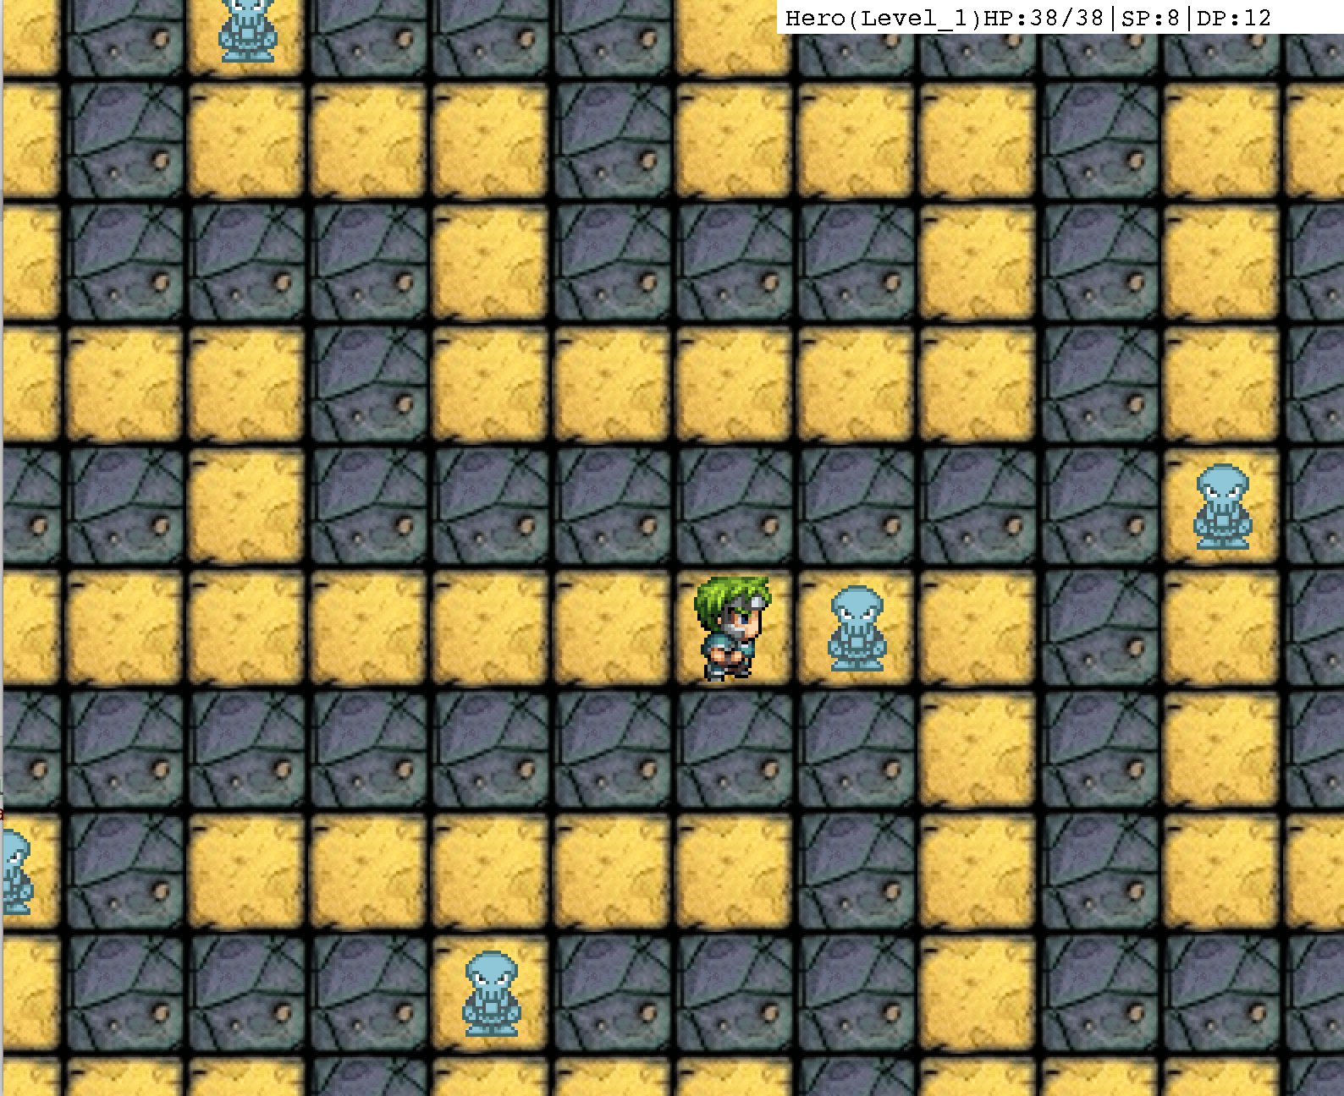
TKWANDERER

Slide 7
class Maze
void drawBackground(Graphics g) {
for(int i = 0; i < MAZE_WIDTH; i ++) {
for (int j = 0; j < MAZE_HEIGHT; j ++) {
Graphics2D g2d = (Graphics2D) g; g2d.drawImage(getTile(i,j).orElse(FLOOR).getTileType(),
i * Tile.tileSize ,j * Tile.tileSize , null); } } }
class Board
private void draw(Graphics g) {
controller.getMaze().drawBackground(g);
for(int i = 0; i < controller.getMonsterList().size(); i++) {
controller.getMonster(i).drawCharacter(g);
}
controller.getHero().drawCharacter(g);
controller.displayStat(g);
}

Slide 8
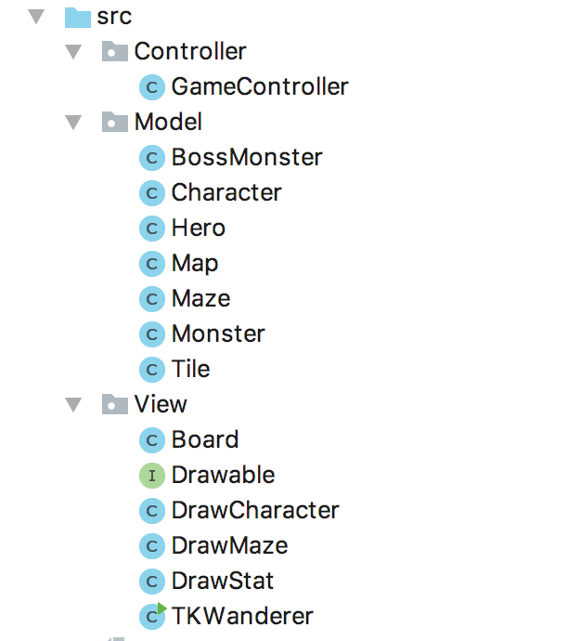
BEFORE
AFTER
View
Drawable
Board

Slide 9
private void drawGame(Graphics g) { int camXPos = controller.getHero().getX() * tileSize
- TKWanderer.SCREEN_WIDTH/2; int camYPos = controller.getHero().getY() * tileSize
- + TKWanderer.SCREEN_HIEGHT/2; g.translate(camXPos, camYPos);
drawCharacter.setCharacter(controller.getHero()); drawCharacter.draw(g);
}

Slide 12
private static int clamp(int x, int low, int high) { return Math.max(low, Math.min(high, x)); }
int camXPos = clamp(controller.getHero().getX() *
tileSize, boundLeft, boundRight); int camYPos = clamp( controller.getHero().getY() *
tileSize, boundTop, boundBottom); int offSetX = - camXPos + TKWanderer.SCREEN_WIDTH/2; int offSetY = - camYPos + TKWanderer.SCREEN_HEIGHT/2 ;
g.translate(camXPos, camYPos);

Slide 13
g.translate(-offSetX, -offSetY);
drawStat.draw(g);

Slide 15
THANK YOU FOR YOUR ATTENTION!

